Slide 2
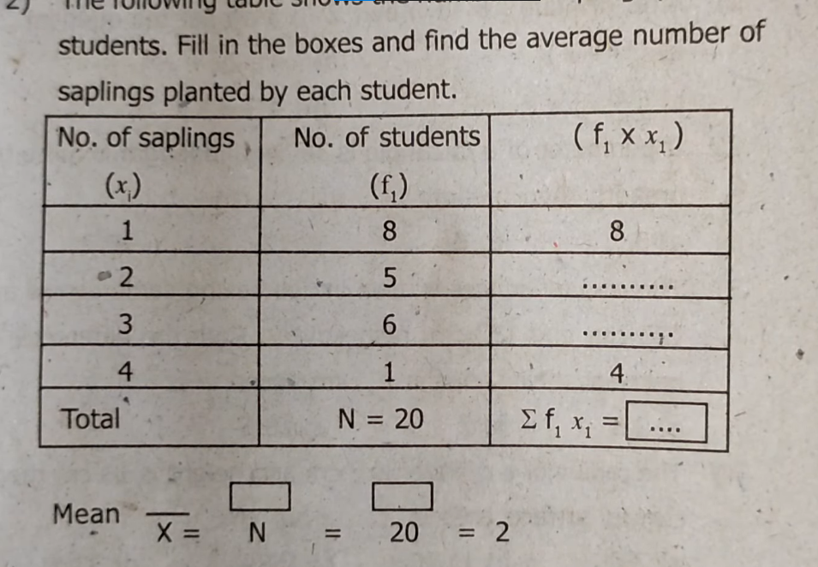
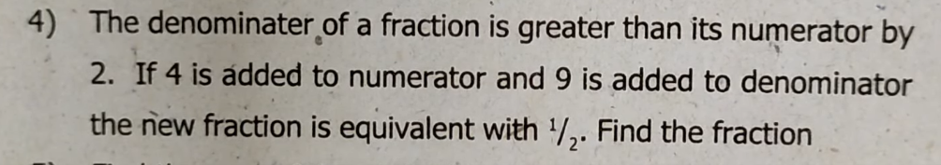
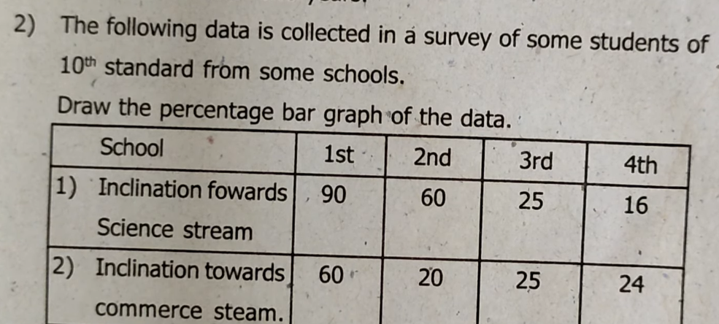
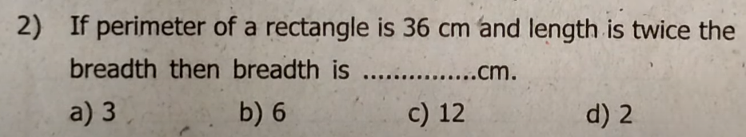
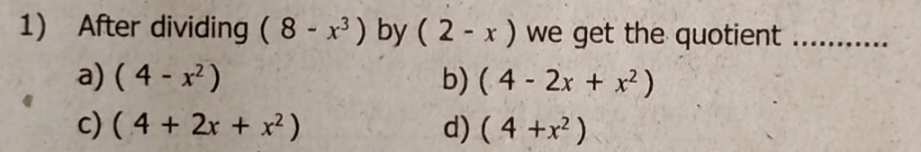
Second unit test
20 MARKS

Slide 3
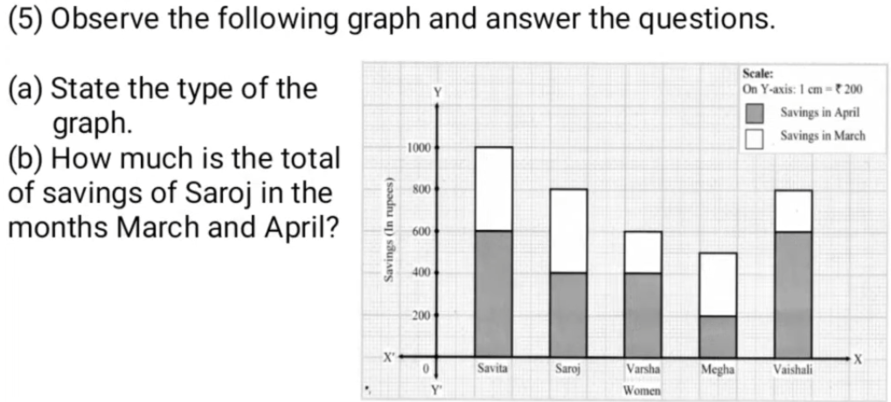

Slide 4
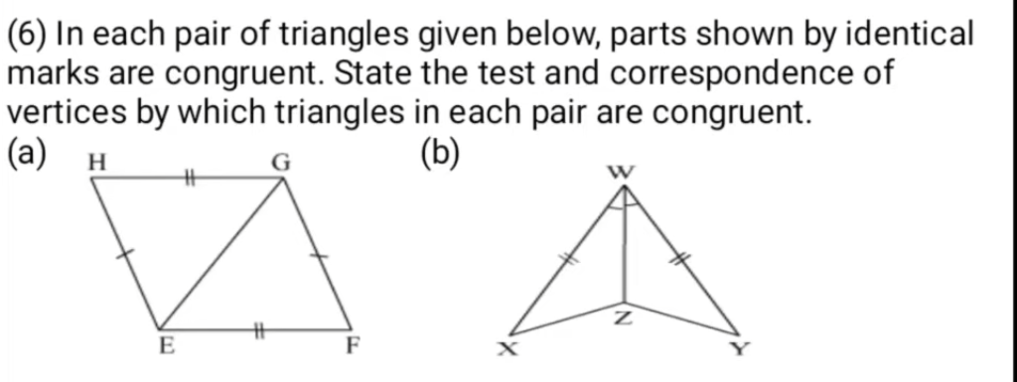
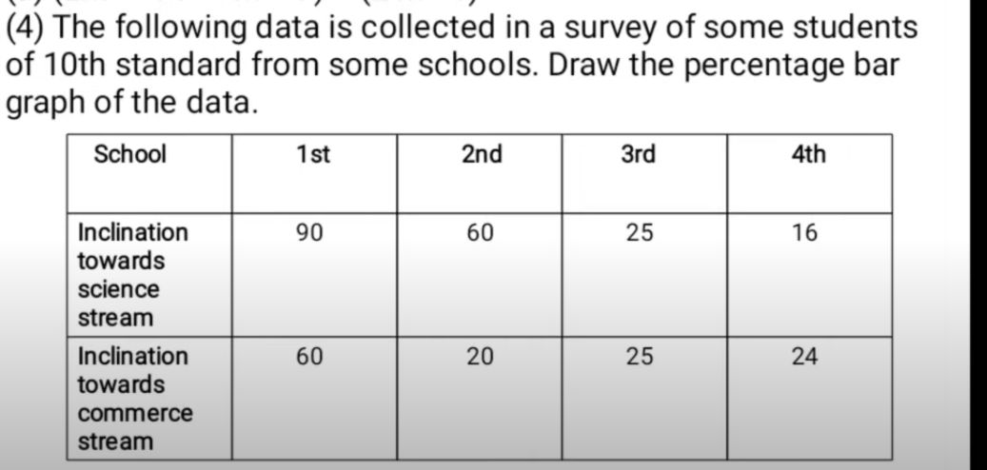

Slide 5
8th
Maths
Question Paper
Maharashra Board

Slide 6
Let’s Solve with
Crystal concept

Slide 7
Any Help?
1
8830979037
SUBSCRIBE

Slide 8
Let’s Solve with
2
Crystal concept
SUBSCRIBE

Slide 9
Let’s Solve with
3
Crystal concept
SUBSCRIBE

Slide 10
Any Help?
4
8830979037
SUBSCRIBE

Slide 11
Let’s Solve with
Crystal concept
6
SUBSCRIBE

Slide 12
Let’s Solve with
Crystal concept
7
SUBSCRIBE

Slide 13

Let’s Solve with
9
Crystal concept

Slide 14
Let’s Solve with
Crystal concept
10
SUBSCRIBE

Slide 15
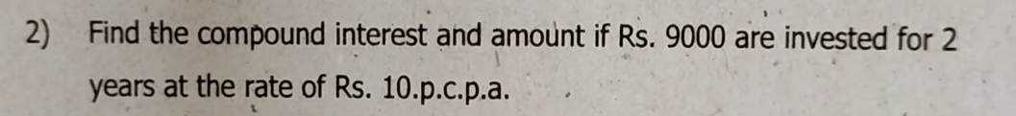
Any Help?
11
8830979037
SUBSCRIBE

Slide 16
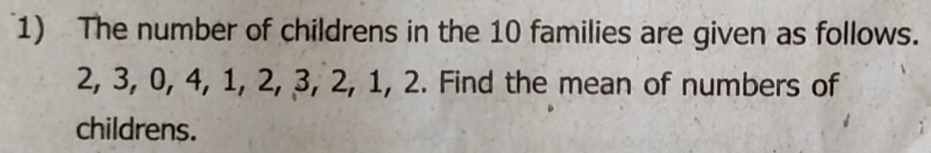
Let’s Solve with
12
Crystal concept

Slide 17
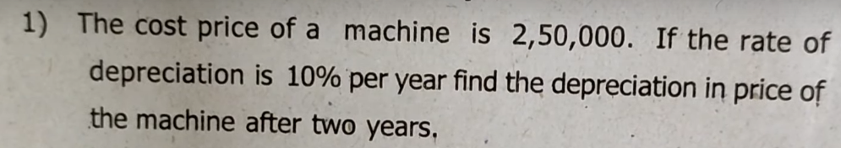
Any Help?
13
8830979037

Slide 18
Let’s Solve with
Crystal concept
14
SUBSCRIBE Kiya?

Slide 19
Let’s Solve with
Crystal concept
14
SUBSCRIBE Kiya?

Slide 20
Press subscribe button
Check description | More Video

Slide 21
Let’s Solve with
Crystal concept

Slide 22
Let’s Solve with
Crystal concept

Slide 23
Let’s Solve with
Crystal concept

Slide 24
Let’s Solve with
Crystal concept

